Slide 1
Does It Work?
Evaluating Your Program

Slide 2

Objectives
Know how to use different methods of evaluation.
Be able to match your evaluation methods with your program objectives.
Know where to apply methods for evaluation in the different stages of your program.

Slide 3

Handouts
Evaluation Worksheet
The Evaluation Procedure
Matching Objectives with Evaluation Methods
Evaluation Methods
Practice Journal Article
Adapting the Evaluation Case Study Activity: Worksheet
Adapting the Evaluation Case Study Activity: Possible Answers.

Slide 4
Questions
When you think of evaluation, what first comes to mind?
How do you define evaluation?

Slide 5
The Purposes of Evaluation
Evaluation helps you to:
See whether program objectives were met
Document the strengths and weaknesses of the program
Have data for keeping good financial records
Improve staff member skills in planning, conducting, and evaluating activities
Meet grant or contract requirements
Promote public relations and awareness
Find out the extent to which a program or its components are appropriate for other populations or settings
Add to the knowledge base of health education program design
Identify hypotheses about behavior for future evaluation.
From Windsor et al., 1994

Slide 6

Process Evaluation
Process evaluation can find problems early on in the program.
  It includes an assessment of the staff, budget review, and how well the program is doing overall.
  For this kind of evaluation, it may be useful to keep a log sheet to record each of your activities.
  From Windsor et al., 1994

Slide 7
Impact Evaluation
Impact evaluation can tell if the program has a short-term effect on the behavior, knowledge, and attitudes of your population.
It also measures the extent to which you have met your objectives.
      From Green and Kreuter, 1991

Slide 8

Outcome Evaluation
Outcome evaluation looks to see if the long-term program goals were met. These goals could be changes in rates of illness or death, as well as in the health status of your population.
From McKenzie & Smeltzer, 1997

Slide 9
Activity
In the first column of Handout #2: Evaluation Worksheet, write down a personal goal and objective. For example:
  Goal: I want to lose weight.
  Objective: I want to lose 10 pounds in 2 months.

Slide 10
Activity
In the second column, write one activity that will help you achieve your objective. For example:
  I am going to learn ways to reduce the calories I eat each day and eat only 1,300 to 1,500 calories a day.
In the third column, write one way to measure if your activity is working. For example:
  I am going to keep a journal of what I eat, including how many calories.
  I am going to weigh myself once a week.

Slide 11
Activity
In the fourth column, write what you hope to learn from your evaluation activity. For example:
  I hope to learn how many calories I am eating and how much weight I am losing each week.
In the fifth column, write down the materials you will need to conduct your evaluation. For example:
  I will need a journal, a writing instrument, a book with the calorie content of common foods, and a scale.

Slide 12
Activity
In the sixth column, write what you hope to learn from your evaluation method that would tell you if you are achieving your goal. For example:
  I hope to learn from the journal writing exercise that I am eating between 1,300 and 1,500 calories a day and am losing 1 to 2 pounds a week.
  After 2 months I hope to learn that I have lost 10 pounds.

Slide 13
So What?
In order for your personal plan to work, you need to think about how you are going to get from one step to the next.
  Think about how you are going to find out if you have achieved your goals and objectives.
    Would you set a goal that you want to lose weight without ever measuring your weight loss?

Slide 14
Discussion Question
Q: When should you begin to think about program evaluation?
A: From the very beginning.
  Evaluation should be a part of the whole planning and implementation process.
    Do not misinterpret the order in which you are receiving this module. It does not mean that evaluation comes last.

Slide 15
Evaluate From the Beginning
Evaluation begins with your audience or needs assessment.
  Use the data you collect about your audience to find out how it is affected by the health issue before your intervention. This is your “baseline.”
  The baseline will help you to measure the effect that your program has on your audience.
    The outcome of your program has no value if you do not know where your audience was before the start of the program.

Slide 16


Pre- and Post-Evaluation
You may develop a way to compare the baseline data from the needs assessment with the final outcome of your program. This will let you see if you have achieved your objectives.

Slide 17
Questions
Now that you know when you should evaluate, how do you do it?
If you have done an evaluation before, how did you select your methods?

Slide 18
The Evaluation Procedure
Planning—Develop the questions, consult with the program stakeholders or resources, make a timeline
Data Collection—Pilot testing. How will the questions be asked? Who will ask them?
Data Analysis—Who will analyze the data and how?
Reporting—Who will report and how? Who will receive the data and when? How will it affect the program?
Application—How could your results be applied in other places?
( Refer to Handout #3: The Evaluation Procedure.)

Slide 19
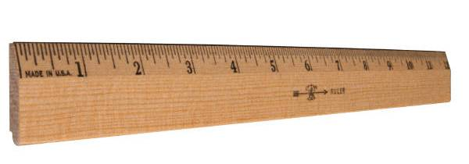
Program Objectives and Evaluation
Your objectives should be measurable so that they can be evaluated.
The evaluation should be in line with your objectives.

Slide 20
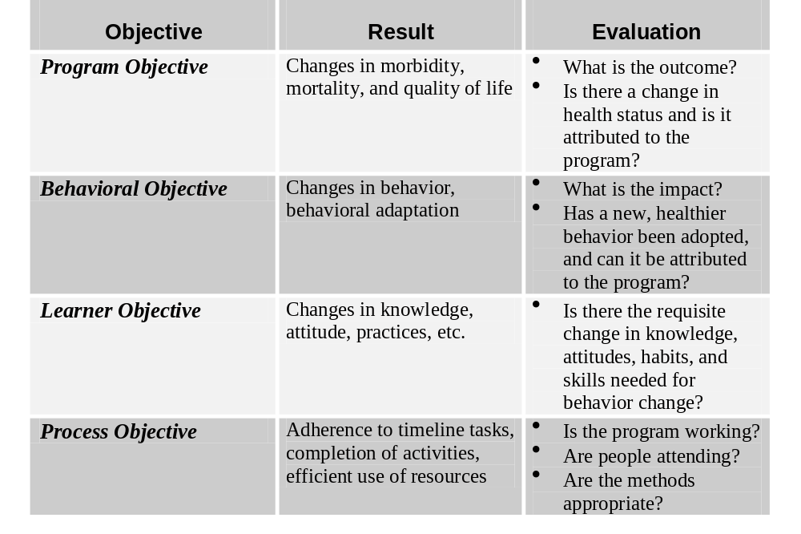

Slide 21

Pilot Testing
You may want to do a pilot test in order to evaluate the effect of your program. (A pilot test is a practice run using a small group who are similar to your target audience.)

Slide 22

Pilot Testing
In a pilot test you collect feedback about the program from this test group. You evaluate the pilot program, and make needed changes in your program before you carry it out with the wider audience.
It gives you a chance to see if there
are any major problems before
you commit yourself to the program.
Pilot testing lets you get an idea of possible evaluation results.

Slide 23

Q: When Should Evaluation Be Made a Part of Your Program?
A: During program adaptation.
For a program to be “evidence-based,” it must have been evaluated. Therefore, each program you use will already have some suggested evaluation methods.
Keep in mind how the changes you make to the program will affect your evaluation methods.
You may need to adapt these methods to your needs and resources.

Slide 24

Replicating the Evaluation
Evidence-based programs have already done some type of evaluation.
Look to see how the program was evaluated before. Try to use the same methods.

Slide 25
Evaluation Methods
Evaluation methods can be found in journal articles about the original study.
Contacting the project officer for your selected program can also be helpful.
  This person can give you input on any challenges or obstacles you may find when doing the evaluation.

Slide 26
Activity Results
Goal: Evaluate the usefulness of the information aid for women with a family history of breast cancer.
Objectives:
  1. Evaluate women’s satisfaction with the aid
  2. Assess the effect of the aid on women’s knowledge, breast cancer-related anxiety, risk perception, and attitudes toward screening.
Evaluation Method: Questionnaires

Slide 27
Changing Your Evaluation Methods
You may change your evaluation methods if:
You do not have the same resources as they had in the original program.
The methods do not fit your objectives.
  This should rarely be the case. The objectives should not have changed much from the original program.
The methods will not be appropriate for your audience.

Slide 28
Case Study Activity
Intervention protocol:
Introductory mailing.
Home visits and group meetings with video, visual aids, and counseling focused on barriers to Pap test screening.
Help with logistics. This could include referral to local clinics, scheduling appointments, interpreter services at clinics, and help with transportation.

Slide 29
Evaluation Worksheet
Evaluation Activities column
  Look for possible evaluation activities. They should be based on the goals and objectives as well as planned program activities.
Evaluation Results column
  Brainstorm about what you hope to learn from the evaluation.
Evidence of Activities and Quality column
  Brainstorm about what kinds of materials will be needed.
    For example, a focus group would require a question guide and consent forms. You might need instruction materials for the participants.
Evidence of Results column
  Think about what kind of results would show that an objective has been met.
Notes:
Discuss. There are no right or wrong answers. Please record group responses for each column on a piece of paper.

Slide 30
Objectives
Know how to use different methods of evaluation.
Be able to match your evaluation methods with your program objectives.
Know where to apply methods for evaluation in the different stages of your program.

Slide 31

Questions?

